Slide 1
Nudge App
Boost user engagement by suggesting
Copilot Chat prompts within Teams 1:1 chat messages.

Slide 2

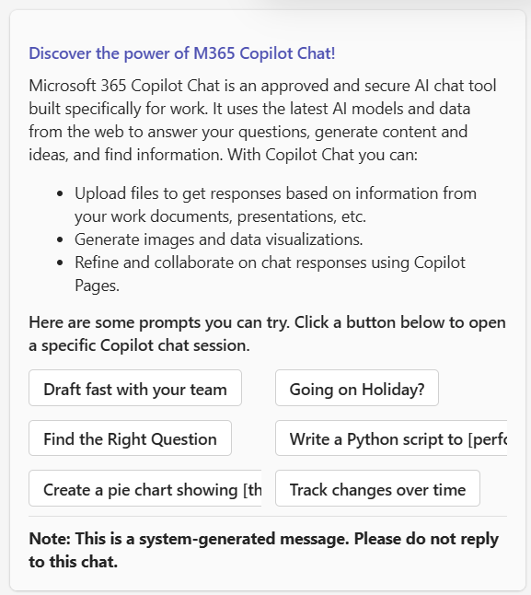
Nudge App for All users
Engage users to try Copilot related prompts & features
Problem statement
For Copilot users, many employees don’t discover or try Microsoft Copilot in the flow of work. Traditional comms (email, portals, town halls) create awareness but don’t convert to first use or habit. Adoption teams also lack a lightweight, targeted, and measurable way to nudge specific cohorts
Solution
The Teams Nudge App delivers interactive Adaptive Cards with curated prompts directly to users in 1:1 chats, meeting them where they work to accelerate time‑to‑first‑value, increase weekly active usage, and capture proven prompts—all with a script‑driven, Microsoft Graph–based approach you can run at scale
Impact
Turn awareness into action
Personalized Nudges
Boosts Adoption
Dynamic Messaging
Adapt to Organizational Needs
Demo video [MS Internal] Nudge App for All users
Teams 1:1 messages received example

Slide 3
Solution implementation
Engage users to try Copilot related prompts & features
Review the solution
Prepare your message
Run the solution
Following the documentation & prerequisites, you will have a clear overview of the solution and can proceed when certified.
Review the messages to be sent and identify targeted audiences
Run the script with the appropriate user.xlsx target and message on demand

Slide 4
Nudge App for All users
Engage users to try Copilot related prompts & features
1- Secure Sponsorship
2- IT Admin activation
3- Communication plan
Secure Executive interest & sponsorship to enable IT and ACM Departments to free appropriate time to understand the value and certify the solution
Read the script documentation & requirement, certify the solution and register the app on behalf of the Organization.
Customize the script if needed & Run the script every working day through December unless you automate it
Familiarize with the solution, and validate that the prompts provided with the solution are relevant for your organization

Slide 5
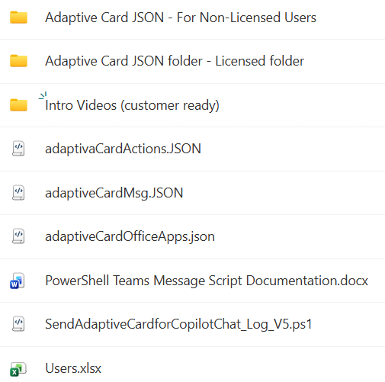
Solution Content
User file and messages powered by a PowerShell Script
Source [Public] : https://aka.ms/nudgeapp
Source [MS internal] : https://aka.ms/gsa/nudgeapp
Predefined messages to be sent to Copilot Non licensed users
Predefined messages to be sent to Copilot licensed users
Videos introducing the solution
Templated JSON files for the overall message layout
PowerShell Script Documentation for IT pros
PowerShell Script to automate sending the messages
Excel file containing the targeted user emails

Slide 6
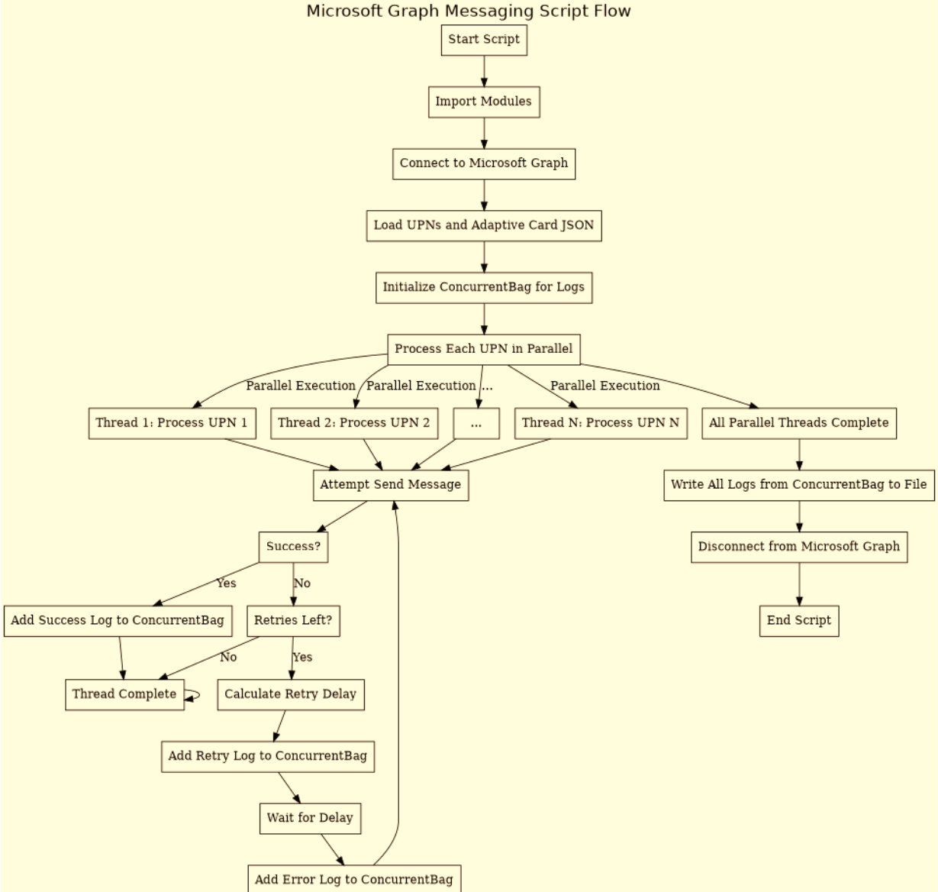
Script workflow
Engage users to try Copilot related prompts & features

